Slide 1


NEXA MARUTHI

Slide 2
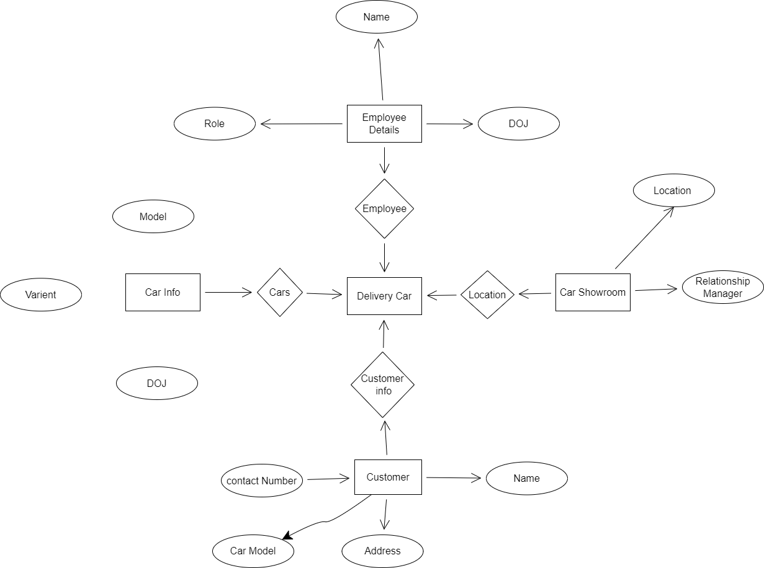

Slide 3




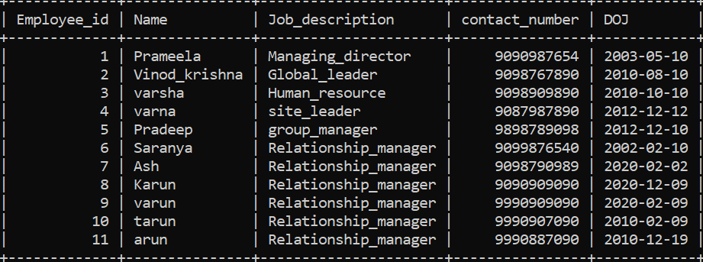
Employee Details

Slide 4

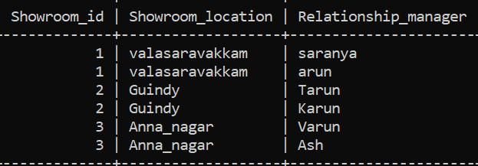
Nexa Showroom

Slide 5

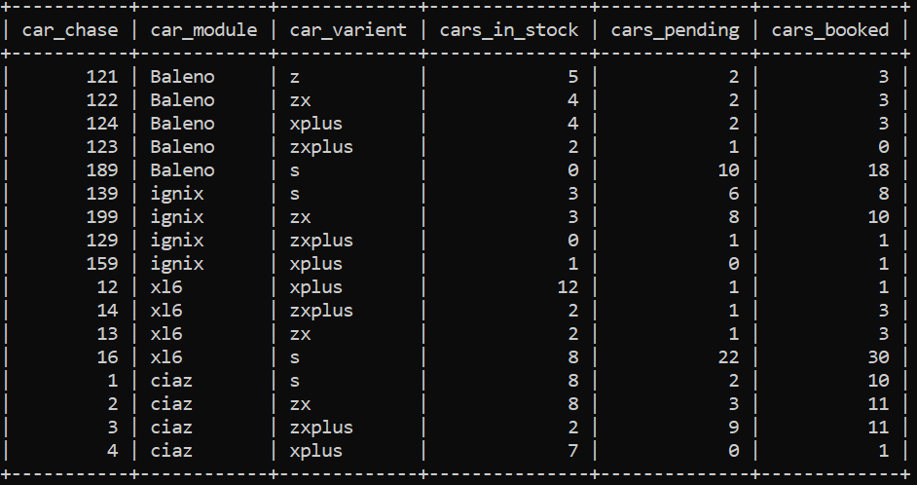

Car Information and

Slide 6

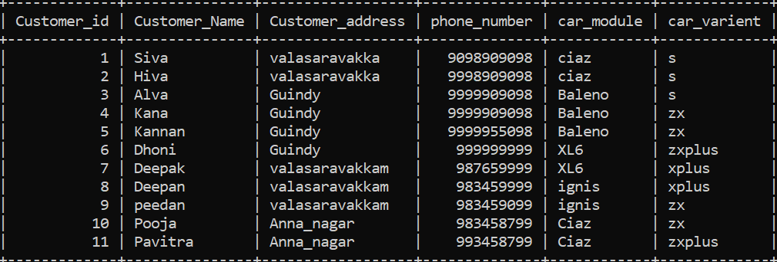
Customer Details

Slide 7



Delivery Details

